Slide 1
Building Sustainable
Family, School, & Community Partnership Networks

Slide 2
Community Partnership Integration Support
Roberta Price Gardner
Assistant Professor
Reading & Literacy Education
Department of Early Childhood & Elementary Education
Kennesaw State University

Slide 3
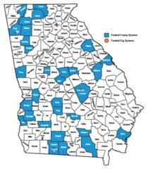
Centering Communities
L4GA 2019 Grantees: Burke County Schools, Butts County Schools, Charlton County Schools, Clayton County Schools, Cook County Schools, Elbert County Schools, GaDOE State Schools, Glascock County Schools, Grady County Schools, Haralson County Schools, Lanier County Schools, Liberty County Schools, Newton County Schools, Paulding County Schools, Pike County Schools, Pulaski County Schools, Rockdale County Schools, Terrell County Schools, Toombs County Schools, Treutlen County Schools, Troup County Schools, Union County Schools, Vidalia City Schools​
40% England
72% Written
85% Subtitle Here

Slide 4
Developing & Assessing Your Partnership Network
Local Community & Businesses
District
Students and Families, Teachers, Administrators, Staff
Gardner, 2017

Slide 6
PARTNERSHIP CONTINUUM
Tier 1 | Tier 2 | Tier 3
Key gaps or elements related to literacy supports, Natural partners needed, child/family/institution not identified or represented or across the B-5 ,K-12 continuum | Some direct/indirect partners listed but gaps exist in literacy supports or social, emotional, intellectual supports child/family or within the B-5 ,K-12 continuum Natural partners but key areas | Identified direct and indirect spheres of influence related to literacy support and the whole child/family social, emotional intellectual across B-5 ,K-12 continuum community partners in multiple domains across spectrum B-5 ,K-12, P20
Few partners or significant gaps/ omissions, routines, structures, task, actions, timelines not identified | Partners listed as assets without clear routines, structures, tasks, actions, or timelines | Clearly established routines, structures, tasks, actions, and timelines who, what, when, where, how much and how often
Measures of effectiveness and accountability don’t exist yet or not established | Limited measures of effectiveness and accountability informal agreement | Measures of effectiveness and accountability-MOU’s
Communication channels/feedback loop loose or not identified | Communication channels limited, not fully explored, limited or no feedback loop or not clear | Multiple Communication Channels Fluid with Feedback Loop
Where is your district/school on the Partnership Continuum?

Slide 7
Nature of Community Partners
Logistics
Who
What
When
Where
How Often
Push In/Push-Out

Slide 8
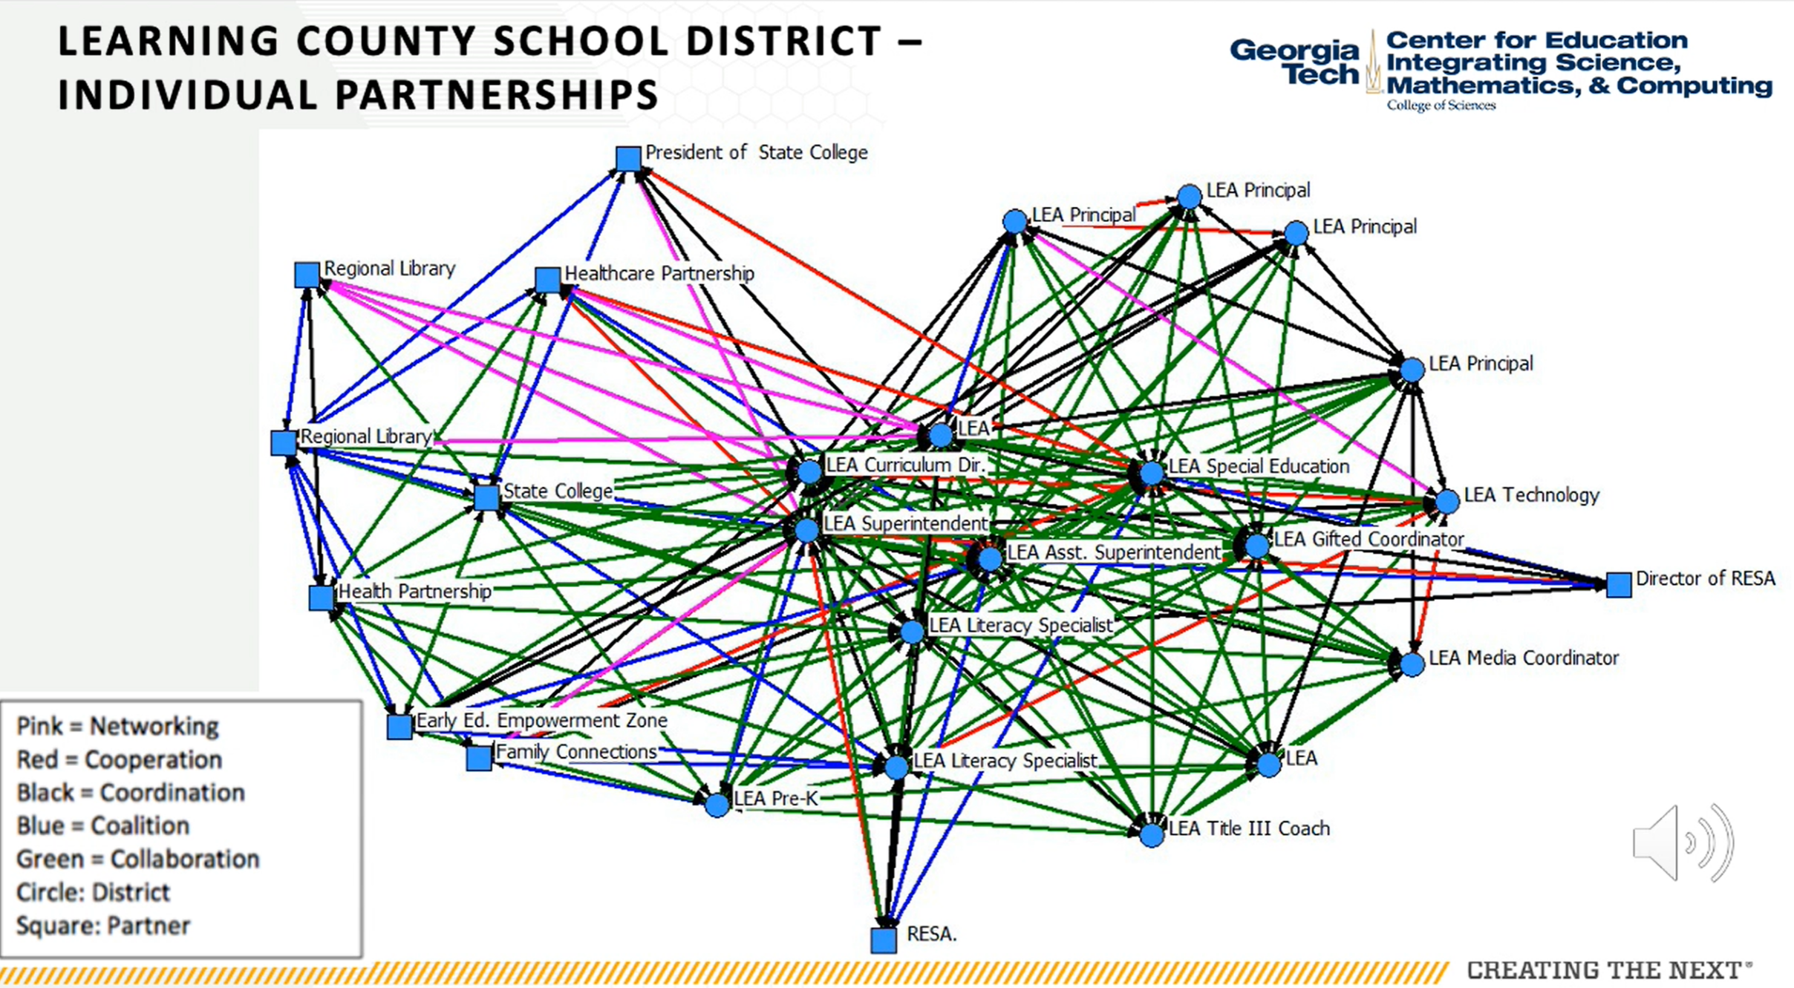
Developing & Sustaining Your Networks
Key Spheres of Influence
Social, emotional, Intellectual
Structures of Opportunity
Comfort and Support Creating
Welcoming Communal Contexts
Sociocultural/Meaningful contexts
Opportunity / Access Gap
(Epstein, 2011; Sanders, 2006; Williems & Gonzalez-DeHass, 2012)

Slide 9
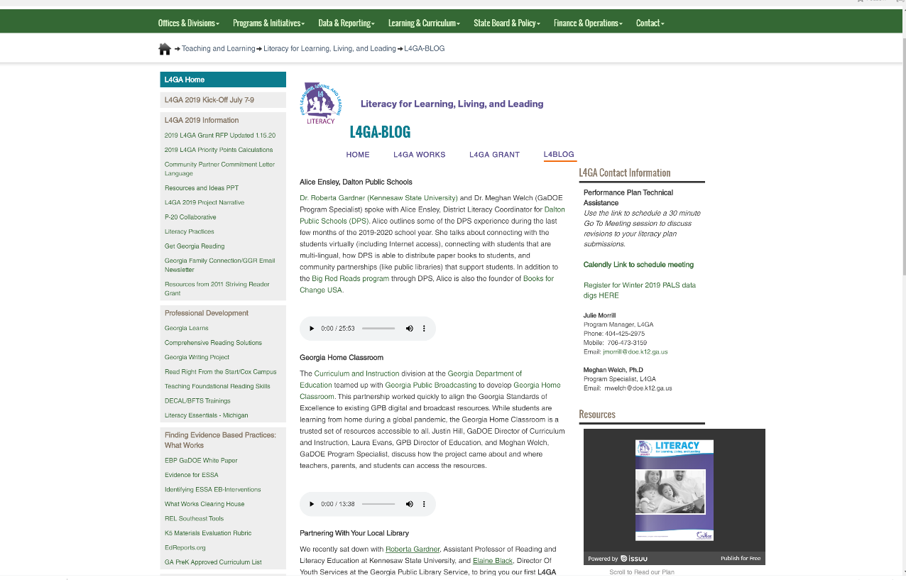
L4 GA Resources & Supports
L4 GA Resources & Supports
Literacy in the Laundromat
Supporting Multi-lingual Students & Families
Developing & Sustaining B-5 Partnership

Slide 10
Community Partnership Support
Curriculum and Assessment
B-5
P20 Partnership
Professional Learning Communities
Development/ Sustainability
Notes:
Wash & learn, overhaul literacy night, virtual book club, tutoring).

Slide 11
Questions ?
Roberta Price Gardner, Ph.D.
Kennesaw State University
rgardn21@Kennesaw.edu
Sian Lott- Program Specialist L4GA
Georgia Department of Education slott@doe.k12.ga.us
Lisa Albert- Program Specialist L4GA
Georgia Department of Education lisa.albert@doe.k12.ga.us
Meghan Welch, Ph.D.- Program Specialist, L4GA
Georgia Department of Education mwelch@doe.k12.ga.us

